Slide 1
Introduction to MATLAB
SOEN385
Control Systems and Applications

Slide 2
MATLAB
Name stands for matrix laboratory
Interactive system for doing technical computations
First version written in the 1970s!
Evolved into a successful commercial software package
Integrates computation, visualization, and programming.

Slide 3
MATLAB
Language of technical computing
Matrix-based system for performing mathematical and engineering calculations.
  MATLAB has only one data type: matrix, or a rectangular array of numbers.
  All variables handled in MATLAB are matrices.
Has an extensive set of routines for obtaining graphical outputs.

Slide 4
MATLAB
In university environments
  is the standard instructional tool for introductory and advanced courses in mathematics, engineering, and science
In industry
  is the tool of choice for high-productivity research, development, and analysis.

Slide 5
MATLAB
Typical uses:
  Math and computation
  Algorithm development
  Data acquisition
  Modeling, simulation, and prototyping
  Data analysis, exploration, and visualization
  Scientific and engineering graphics
  Application development, including GUI building

Slide 6
MATLAB
Powerful toolboxes
  Extending the environment to solve particular classes of problems:
    Symbolic Math
    Control System
    Neural Networks
    Partial Differential Equations
    Signal and Image Processing
    ...

Slide 7
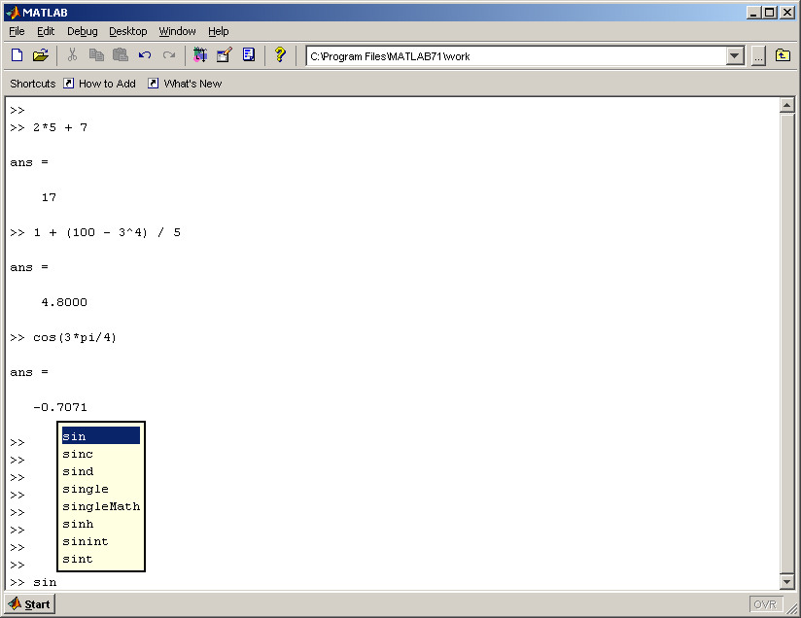
Diving into MATLAB
MATLAB as a calculator:

Slide 8
MATLAB Commands
MATLAB is usually used in a command-driven mode.
Some commonly-used commands:
  help
    Displays help text in Command Window.
  clc
    Clears the command window and homes the cursor
  who, whos
    List the variables in the current workspace
  clear
    Removes all the variables from the workspace
  save,load
    Saves/loads workspace variables to/from disk
  class
    Returns the class of an object.
  clock, date, computer, …

Slide 9
How to Use MATLAB?
Command driven:
  MATLAB processes single-line commands immediately and displays the result.
Script driven:
  MATLAB is also capable of executing sequences of command that are stored in files.
    These source files are called m-files, having a .m extension.

Slide 10
Matrix Operators
+ Unary Plus/Addition
- Unary Minus/Subtraction
* Multiplication
^ Power
‘ Conjugate transpose
/ or \ Matrix division
./ or .\ Array division

Slide 11
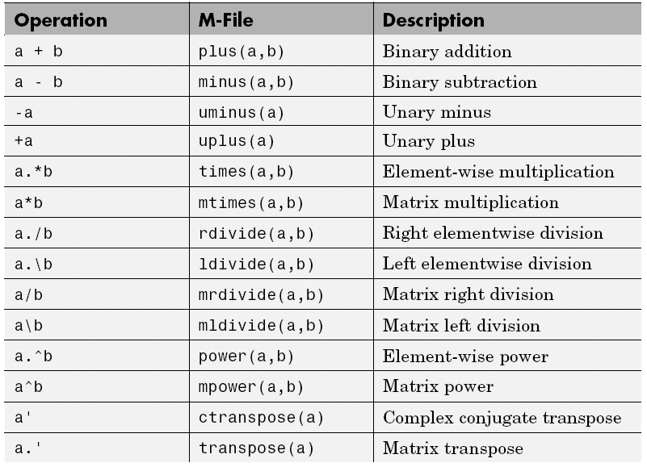
Matrix Operators

Slide 12
Relational and Logical Operators
< Less than
<= Less than or equal to
> Greater than
>= Greater than or equal to
== Equal
~= Not equal
& AND
| OR
~ NOT
Note that = is used in an assignment statement, while == is used in a relation.

Slide 13
Misc Operators
[] Used to form vectors and matrices
() Arithmetic expression precedence
, Separate subscripts and function arguments
; End rows; suppress printing
: Subscripting, vector generation
! Execute operating system command
% Comment

Slide 14
Semicolon Operator
Use of semicolon
  Suppressing printing
    If an statement is terminated with a semicolon, printing is suppressed.
      The command is still executed, but the result is not displayed.
  Entering matrices
    A semicolon is used to indicate the end of a row, except for the last row.

Slide 15
Colon Operator
Use of colon
  Creating vectors
  Subscripting matrices
  Specifying iterations
    Example:
      t = 1:5
    Generates a row vector containing the numbers from 1 to 5 with unit increment that is:
    t =
    1 2 3 4 5

Slide 16
Colon Operator
Use of colon
  An increment other than unity can be used. For example:
  t = 1:0.5:3
  will result in:
  t =
  1.0000 1.5000 2.0000 2.5000 3.0000
  Negative increments may also be used.
There are also some commands for generating sequential data such as linspace or logspace.

Slide 17
Functions (Math. Commands)
Some built-in and commonly used mathematical functions:
sin, cos, tan, asin, atan, …
log, log10, log2, exp, …
sqrt, abs, sign, …
real, imag, conj, angle, …

Slide 18
Vectors in MATLAB
Vectors are essentially 1×n or n×1 matrices.
Vectors are used to hold ordinary 1-D sampled data signals or sequences.
There is two types of vectors in MATLAB:
  Row vector
  Column vector

Slide 19
Vectors in MATLAB
Entering vectors into MATLAB:
  No dimension or type statements are needed.
  One way is to enter the vector as an explicit list of elements separated by blank, spaces or commas.
  Example:
  x = [1 2 3 -4 -5]
  or
  x = [1, 2, 3, -4, -5]
A row vector can be turned into a column vector by transposition.
Another way of entering a column vector is to use semicolons or newlines as the element separator.

Slide 20
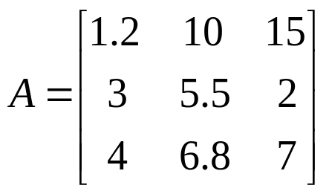
Entering Matrices Into MATLAB
A matrix
may be entered into MATLAB as follows:
A = [1.2 10 15; 3 5.5 2; 4 6.8 7]
Again, the values must be entered within brackets.
As with vectors, the elements of any row must be separated by blanks (or commas).
The end of each row, except for the last one, is indicated by a semicolon.

Slide 21
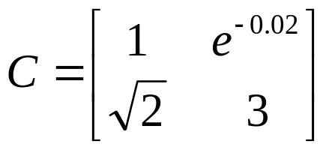
Entering Matrices Into MATLAB
As another example, a matrix
may be entered as:
C = [1 exp(-0.02); sqrt(2) 3]
After the carriage return, the following matrix will be seen on the screen:
C =
1.0000 0.9802
1.4142 3.0000

Slide 22
Generating Vectors/Matrices
Utility functions:
  linspace, logspace
  ones, zeros, eye, diag, rand, randn, magic
Examples:
x = linspace(-10,10,5);
w = logspace(-1,1,10);
I = eye(5);
A = ones(3,4);
B = diag([ones(1,5)]);

Slide 23
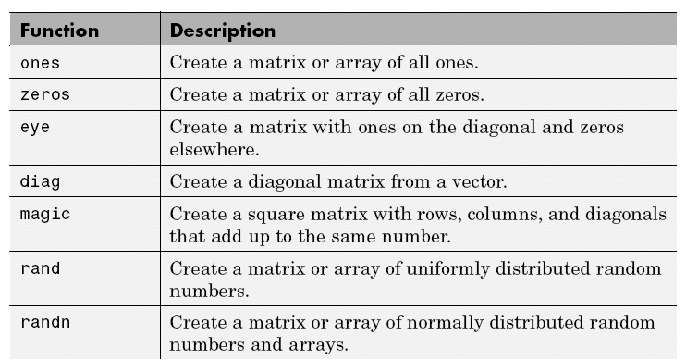
Matrix Constructors

Slide 24
Vector/Matrix Functions
Basic commands:
  length Returns length of a vector
  size Returns number of rows/columns of a matrix
  ndims Returns number of dimensions a matrix
  numel Returns number of elements of a matrix
Utility/Math functions:
  reshape Reshapes a matrix
  sum Returns sum of elements
  min/max Returns minimum/maximum of elements
  inv, det, …

Slide 25
Variables in MATLAB
A convenient feature of MATLAB is that variables need not be dimensioned before they are used.
  A variable’s dimensions are generated automatically upon the first use of the variable, and
The dimensions of the variables can be altered later if necessary.
Example:
>> A = [1 2 3; 4 5 6; 7 8 9];
>> x = [1 2 3];
>> whos
…
>> x = [1 2 3 4 5];
>> A = x’ * x

Slide 26
Variables in MATLAB
Examples of variable names:
  Legal:
averageCost average_cost
n5 N5
Left2Pay
  Illegal:
    Syntactically:
average-Cost average cost
2pay %x
@sign
    Semantically:
      Function Names:
sin, cos, abs, …
      Special Names:
ans, eps, pi, i,j, …

Slide 27
Primitive Numeric Types
C Type | Equivalent MATLAB Type
char, byte | int8
unsigned char, byte | uint8
Short | int16
int, long | int32
unsigned int, unsigned long | uint32
float | single
double | double

Slide 28
Complex Number Type
MATLAB has a built-in support for complex numbers.
Complex numbers in MATLAB are simply represented as A ± Bi or A ± Bj, where A is the real part and B is the imaginary part.
  i and j are used to represent complex numbers. That’s why you shouldn’t use them as ordinary variable names.
Useful functions:
  complex, real, imag, conj, angle
Example:
>> m = sqrt(-3)
>> n = 4 + 7i % == complex(4,7)
>> m*n

Slide 29
More About Matrices
MATLAB is a matrix-based computing environment.
Matrix is the most basic data structure in MATLAB.
All data is stored in the form of a matrix or a multidimensional array.
  Even a single numeric value is stored as a 1-by-1 matrix:
  >> a = 5;
  >> size(a)

Slide 30
Creating Matrices
Create a row in the matrix by entering elements within brackets. Separate each element with a comma or space:
row = [E1, E2, ..., Em]
To start a new row, terminate the current row with a semicolon:
A = [row1; row2; ...; rown]

Slide 31
Concatenating Matrices
Joining one or more matrices to make a new matrix
The expression C = [A B] horizontally concatenates matrices A and B.
The expression C = [A; B] vertically concatenates them.
Example:
A = ones(2, 5) * 6; % 2-by-5 matrix of 6's
B = rand(3, 5); % 3-by-5 random matrix
C = [A; B] % vertically concatenate A and B
We can use the function cat for concatenating along arbitrary dimension.

Slide 32
Numeric Sequences
Useful in constructing and indexing into matrices and arrays.
MATLAB provides a special operator to assist in creating them
  The colon operator: (first:last) generates a 1-by-n matrix (or a row vector) of sequential numbers from the first value to the last.
  Examples:
    >> A = 10:15 >> A = -2.5:2.5
    >> A = 1:6.3 >> A = 9:1
    >> A = 10:5:15 >> A = 9:-1:1

Slide 33
Matrix Indexing
Accessing single elements
  specify the row first and the column second:
A(row, column)
Accessing multiple elements
  Subscript expressions involving colons refer to portions of a matrix.
  A(1:m, n)
  Example:
  >> A = magic(4);
  >> A(1,4) + A(2,4) + A(3,4) + A(4,4)
  >> sum(A(1:4,4))
  >> sum(A(:,4))

Slide 34
Vector/Matrix Indexing
The end keyword
  Designate the last element in a particular dimension of an array.
  Example:
  >> V = [3 7 2];
  >> V(end + 1) = 8;
The colon operator for specifying all elements
  colon by itself refers to all the elements in a row or column of a matrix.
  Example
  >> sum(A(:, 2))
  >> A(:)

Slide 35
Computing Matrix Functions
Norms
  The norm of a matrix is a scalar that gives some measure of the size of the matrix.
  Several different definitions are commonly used, One is:
  norm(A) = largest singular value of A
  Similarly, several definitions are available for the norm of a vector. One commonly used definition is:
  norm(x) = sum(abs(x).^2)^0.5
  MATLAB function: norm

Slide 36

Computing Matrix Functions
Characteristic Equation
  The roots of the characteristic equation of a square matrix A are the same as the eigenvalues of A.
  The characteristic equation of A is computed with the function poly(A).
  Example
  >> A = [0 1 0; 0 0 1; -6 -11 -6];
  >> p = poly(A)
  p =
  1.0000 6.0000 11.0000 6.0000
  This is the MATLAB representation of the characteristic equation

Slide 37
Computing Matrix Functions
Note that polynomials are represented as row vectors containing the polynomial coefficients in descending order.
  That is, in the previous example: p = [1 6 11 6].
The roots of the characteristic equation p = 0 can be obtained with the function roots:
>> r = roots(p)
r =
-3.0000
-2.0000
-1.0000

Slide 38
Computing Matrix Functions
Note that the commands ploy and roots could be combined into a single expression: roots(poly(A))
The roots of characteristic equation may be reassembled back into the original polynomial with the function poly.
>> r = [-3 -2 -1];
>> q = poly(r)
q =
1 6 11 6

Slide 39
Computing Matrix Functions
Addition or subtraction of polynomials
  If the two polynomials are of the same order, simply add the vectors that describe their coefficients.
  If the polynomials are of different order (n and m, where m < n ), then add n-m zeros to the left side of the coefficient vector of the lower order polynomial.
  Example:
  >> a = [3 10 25 36 50];
  >> b = [0 0 1 2 10];
  >> a+b
  ans =
  3 10 26 38 60

Slide 40
Computing Matrix Functions
Eigenvalues and eigenvectors
  If A is an n×n matrix, then the n numbers λ that satisfy Ax = λx are the eigenvalues of A.
  Eigenvalues of A are obtained with the function eig(A), which returns the eigenvalues in a column vector.
  Example:
  >> A = [0 1 0; -1 0 2; 3 0 5];
  >> eig(A)
  ans =
  5.2130
  -0.1065 + 1.4487i
  -0.1065 - 1.4487i

Slide 41
Computing Matrix Functions
Eigenvalues and eigenvectors
  MATLAB functions may have single or multiple-output arguments.
  The function eig(A) for example, produces a column vector consisting of the eigenvalues of A, while the double-assignment statement [X,D] = eig(A), produces eigenvalues or eigen vectors.
    The diagonal elements of the diagonal matrix D are the eigenvalues, and the columns of X are the corresponding eigenvectors such that AX = XD.

Slide 42
Computing Matrix Functions
Convolution (product of polynomials)
  The product of polynomials is the convolution of the coefficients.
  In MATLAB, the product of the polynomials a(s) and b(s) can be obtained with the function conv(a,b).
  Example
  >> a = [3 10 25 36 50] % 3s^4 + 10s^3 + … + 50
  >> b = [1 2 10] % s^2 + 2s + 10
  >> % Define the product of a and b as c
  >> c = conv(a,b)
  c =
  3 16 75 186 372 460 500
  >> % which is 3s^6 + 16s^5 + … + 500.

Slide 43
Computing Matrix Functions
Polynomial evaluation
  If p is a vector representing a polynomial, then polyval(p,s) is the value of the polynomial evaluated at s.
  Example
    To evaluate the polynomial p(s) = 3s^2 + 2s + 1 at s = 5, enter the following commands:
    >> p = [3 2 1];
    >> polyval(p,5)

Slide 44
Plotting
MATLAB has an extensive set of routines for obtaining graphical outputs.
The function plot creates 2D x-y plots.
  Logarithmic or polar plots are created simply by substituting the word loglog, semilogx, semilogy or polar for plot.
  All such commands are used the same way. They affect only how the axis is scaled and how the data are displayed.

Slide 45
Plotting
If x and y are vectors of the same length, the command plot(x,y) plots the values in y versus the values in x.
We can use the plot command with multiple arguments:
plot(X1, Y1, X2, Y2, …, Xn, Yn)
to plot multiple curves on a single graph. The variables Xi and Yi are pairs of vectors.
Plotting more than one curve on a single graph may also be accomplished by the command hold on, or simply hold.

Slide 46
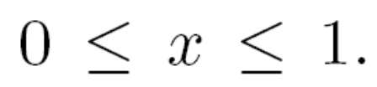
Plotting
To plot a a function, we have to compute (sample) the function at a sufficiently large number of points and then join up the points by straight lines.
Example:
  Plot y = sin(3πx) for 0 ≤ x ≤ 1.
  >> N = 10; h = 1/N; x = 0:h:1;
  >> y = sin(3*pi*x);
  >> plot(x,y);

Slide 47
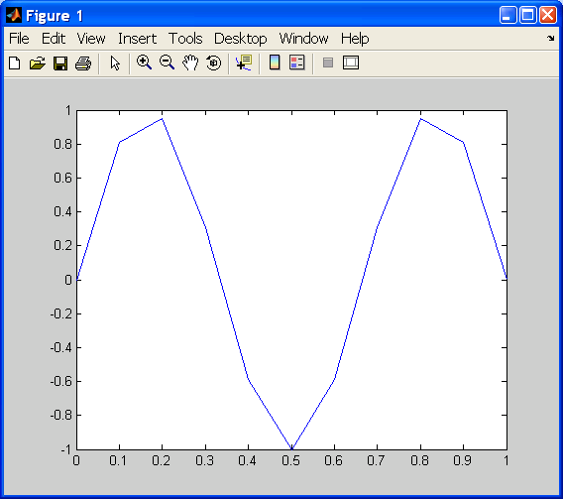
Plotting

Slide 48
Plotting
Useful Functions:
  title
    Adds text at the top of the current axis.
  xlabel, ylabel
    Adds text beside the X/Y-axis on the current axis.
  grid
    Adds/removes grid lines to/from the current axes.
  subplot
    To show several plots in the same figure.

Slide 49
Refrences
MATLAB for Control Engineers, K. Ogata, Prentice Hall, 2008.
MATLAB
The Language of Technical Computing
Programming Version 7
http://www.mathworks.com/access/helpdesk/help/pdf_doc/matlab/matlab_prog.pdf

